Slide 1
Mobile Test Automation Solution
-Introducing Appium Framework
Designed & implemented by
Sandeep Koar (sakoar@Lexmark.com)

Slide 2
Agenda
Introduction to Appium Framework
Tools that are in use (for Android browser test)
Architecture Diagram
Integration with Selenium W/D
Android SDK
Connecting Real device to PC- adb.exe
Capturing Package & Activity for Native App
Capturing objects for Browser app
Live Demo on Test automation executed in Mobile Browser
Notes:
First, let’s explore each organization’s pitch.
[[ CLICK ]]
Screen text: “Lexmark technology removes the inefficiencies of information silos and disconnected processes, connecting people to the information they need at the moment they need it most.”
Lexmark enterprise software excels in intelligent capture, content management, search, and more. For years, we’ve promised and delivered on the revolutionary idea of delivering precise information at the moment of need.
[[ CLICK ]]
Screen text: “Kofax simplifies and transforms the First Mile of customer engagement: the information intensive, real-time interactions customers have with an organization.”
Kofax excels at automating, simplifying and transforming the processes that drive important points of customer interaction, especially the early, capture-heavy processes where succeeding wildly in customer engagement is crucial.
You can already see the synergies – the importance of customer engagement, the simplifying and streamlining of processes, the criticality of information capture.
[[ CLICK ]]
Screen text: “Together, we enable you to boost efficiency, maximize business agility, and increase the value of your business.”
Let’s explore this idea of increasing value in a little more depth.

Slide 3

Introduction to Appium Framework
Appium is an open source test automation framework (http://appium.io/) for use with native, hybrid and mobile web apps. It drives iOS and Android apps using the WebDriver protocol.
Appium is built on the idea that testing native apps shouldn't require including an SDK or recompiling your app.
Appium aims to automate any mobile app from any language and any test framework.
Easy integration with Selenium leverage programmers to write their test in their preferred language

Slide 4



Tools used

Slide 5









Architecture Diagram

Slide 6


Flow Cycle
Solution for Mobile Test Automation

Slide 7
Integration with Selenium W/D
Create a normal java project
Add both selenium jar & selenium RC Standalone jar
Selenium-Java-x.xx.x
Selenium-server-standalone-x.xx.x
Add the relevant libraries to the build path for Appium
gson-2.4
Java-client-3.2

Slide 8
Android SDK
Android SDK needs to be downloaded from http://developer.android.com/sdk/installing/index.html
The folder path needs to be set to environmental variable & path variaible

Slide 9
Connecting Real Device to PC
The Device needs to be connected through USB
Go to phone settings->Developer Options
->Check USB Debugging
->Check Stay Awake
In your PC, go to folder Android SDK->platform-tools, confirm adb.exe present there
In CMD, type
adb start-server
adb devices
You should see the device name appearing in the response.

Slide 10

Capturing Package & Activity for Native App
Run the Activity&PackageInfo class in Eclipse
Capture the logs to Log folder
Open the Log folder in Notepad++
Identify package & Activity for the
browser under test

Slide 11
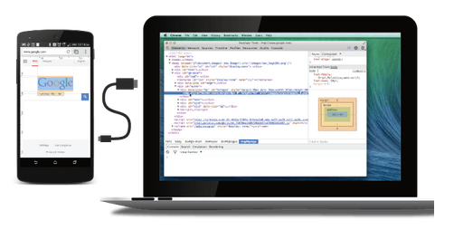
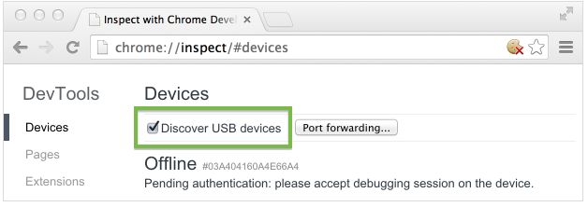
Capturing objects for Browser app
Enable USB debugging in your device (for android, settings->developer options->USB Debugging)
Connect your device
Discover the device in Chrome
Chrome://inspect/#devices
Notes:
Press F5 to see the text of the slides

Slide 12
Agenda
Live demo

Slide 13

Q & A

Slide 14


